Slide 1
CS 295A/395D: Artificial Intelligence
Introduction: What is AI?
Prof. Emma Tosch
19 January 2021

Slide 2
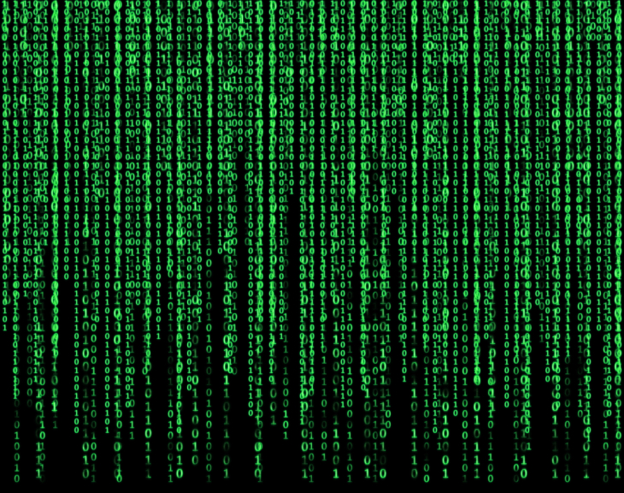

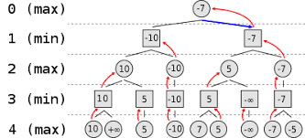
Implemented as glorified if-statements.
Can be understood as part of classical computer science!

Slide 3
Artificial intelligence is the study of heuristic, possibly sub-optimal algorithmic solutions to
NP-hard problems.

Slide 4
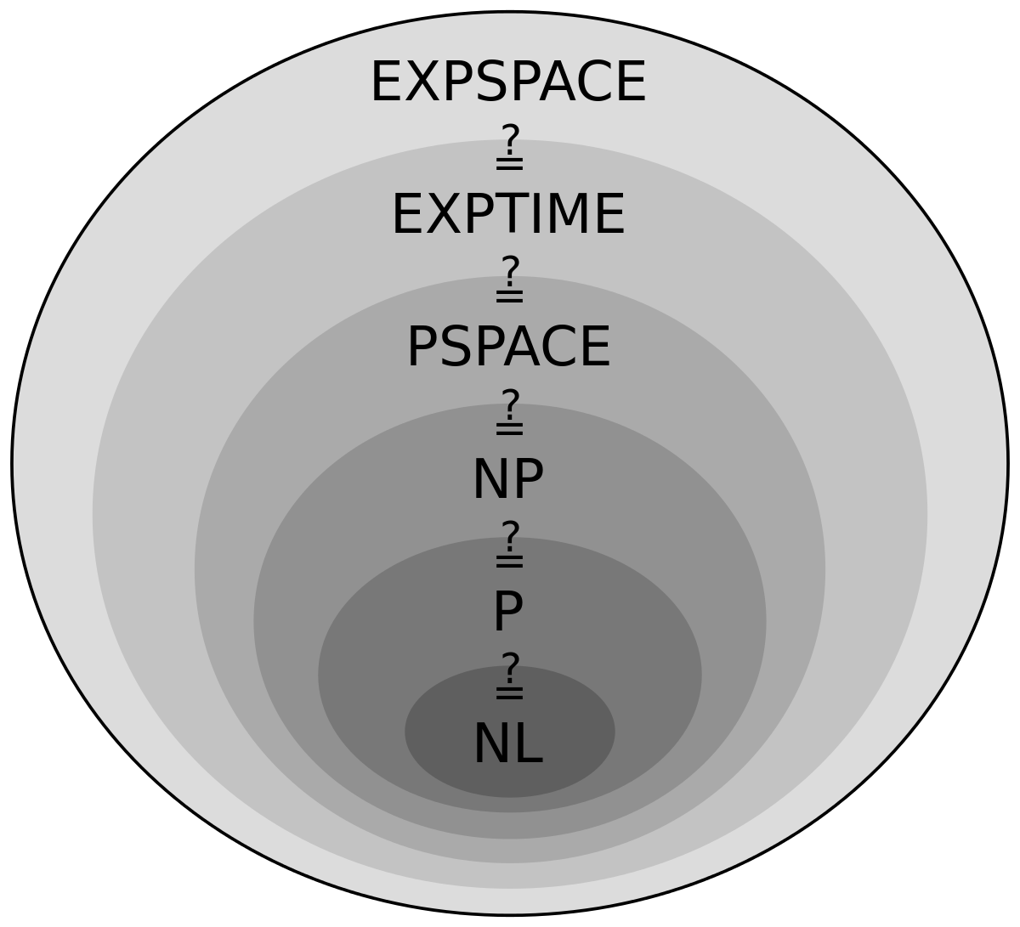
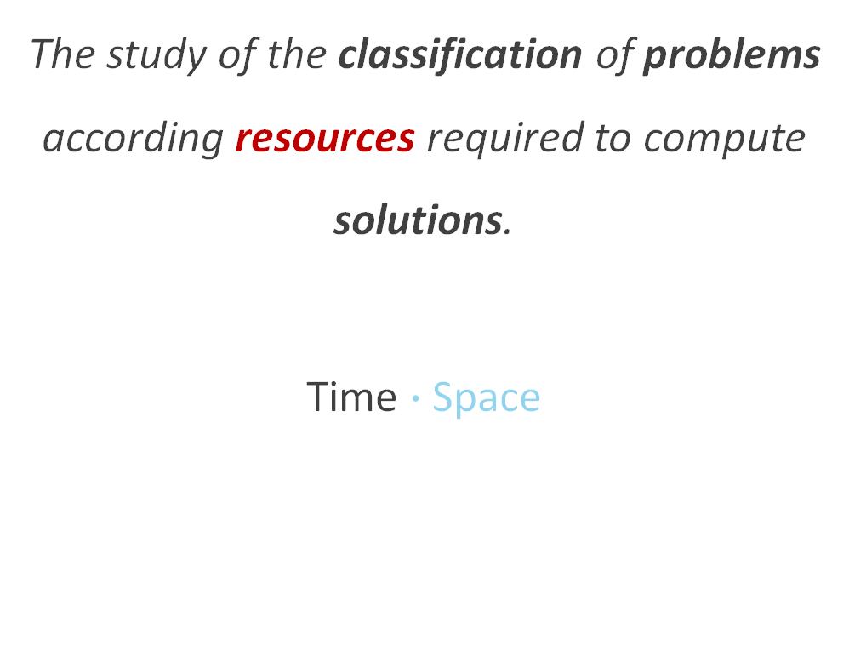
Computational Complexity Theory
The study of the classification of problems according resources required to compute solutions.
Time $∙$Space
(CS 125)

Slide 5
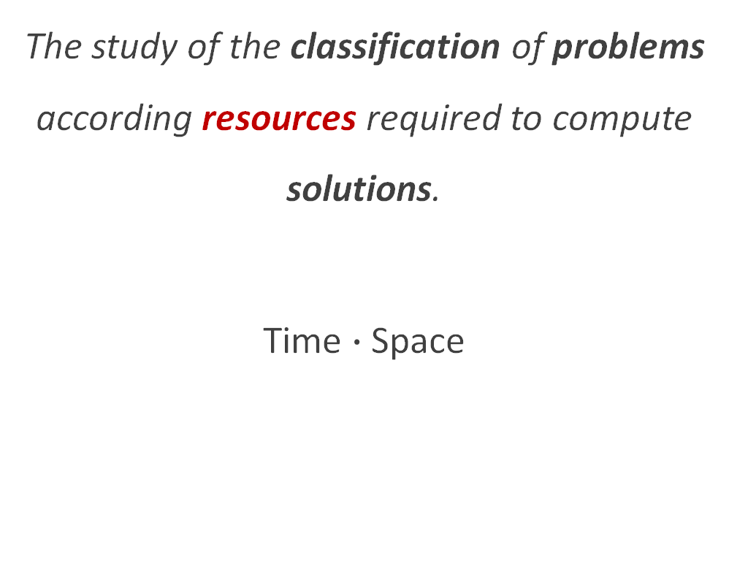
Computational Complexity Theory
The study of the classification of problems according resources required to compute solutions.
Time $∙$Space
(CS 125)

Slide 6
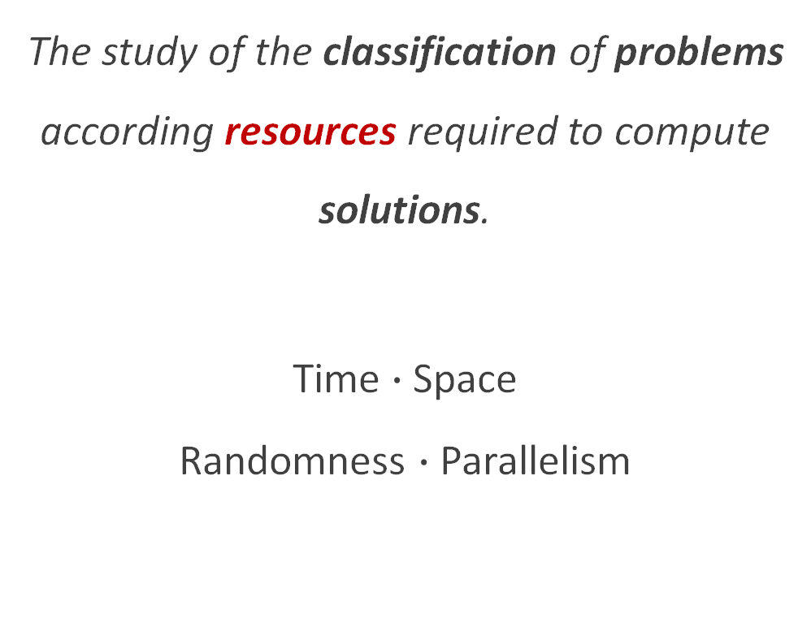
Computational Complexity Theory
The study of the classification of problems according resources required to compute solutions.
Time $∙$Space
Randomness $∙$Parallelism
(CS 125)

Slide 7
Computational Complexity Theory
Classification:
How long to find a solution?
How long to check a solution?
Sometimes we only know the complexity of #2…
So we assume we just have #1…
“N” prefix == “non-determinism”
(CS 125)

Slide 8
Computational Complexity Theory
Classification:
How long to find a solution?
How long to check a solution?
“P vs. NP”
P: #1 AND #2 definitely in polytime
NP: #2 definitely in polytime
#1 at least in polytime
(CS 125)

Slide 9
Computational Complexity Theory
Classification:
How long to find a solution?
How long to check a solution?
Hard problems “start” in NP
NP-Hard: at least as hard as any problem in NP
Exact algorithmic solutions may be impractical
AI makes NP-Hard solutions practical!
(CS 125)

Slide 10
Artificial intelligence is the study of heuristic, possibly sub-optimal algorithmic solutions to
NP-hard problems.

Slide 11
heuristic
A function, technique, rule, or other approach to solving a problem that is practical and returns a good enough (possibly sub-optimal) solution.
Often encodes domain knowledge!
(i.e., uses some specialized knowledge about the problem space)

Slide 12
Example (preview of unit 1)
Boolean satisfiability problem (SAT)
Find an assignment of the variables to make the whole expression true
NP-complete (in NP and as hard as the hardest problems in NP)
Many real-world problems can be expressed as SAT!
DPLL algorithm – foundation that uses cost function + search to find solutions

Slide 13
Or as I like to call it… “applied computer science”
Logic
Probability
🤝
Artificial Intelligence

Slide 14
AI Problem Spaces
Where’s the “artificial intelligence”?
SAT/SMT solvers
Heuristic search (e.g., games, web search)
Planning
Game theory
Decision theory
Sequential decision-making
Not AI:
General algorithms
Data-driven solutions
Machine learning
Statistics
Philosophy of Mind
Cognitive Science

Slide 15
AI Problem spaces
SAT/SMT solvers
Heuristic search (e.g., games, web search)
Planning
Game theory
Decision theory
Sequential decision-making
Not AI:
General algorithms
Data-driven solutions
Machine learning
Statistics
Philosophy of Mind
Cognitive Science

Slide 16
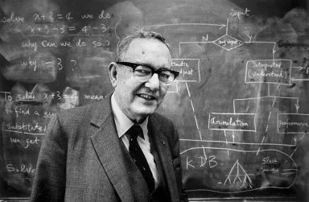
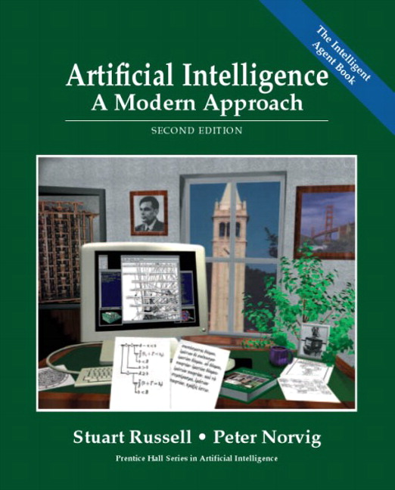
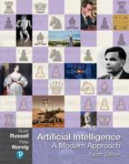
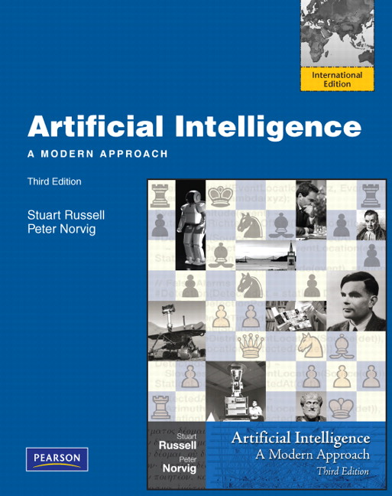
Why do we call it AI?

Slide 17
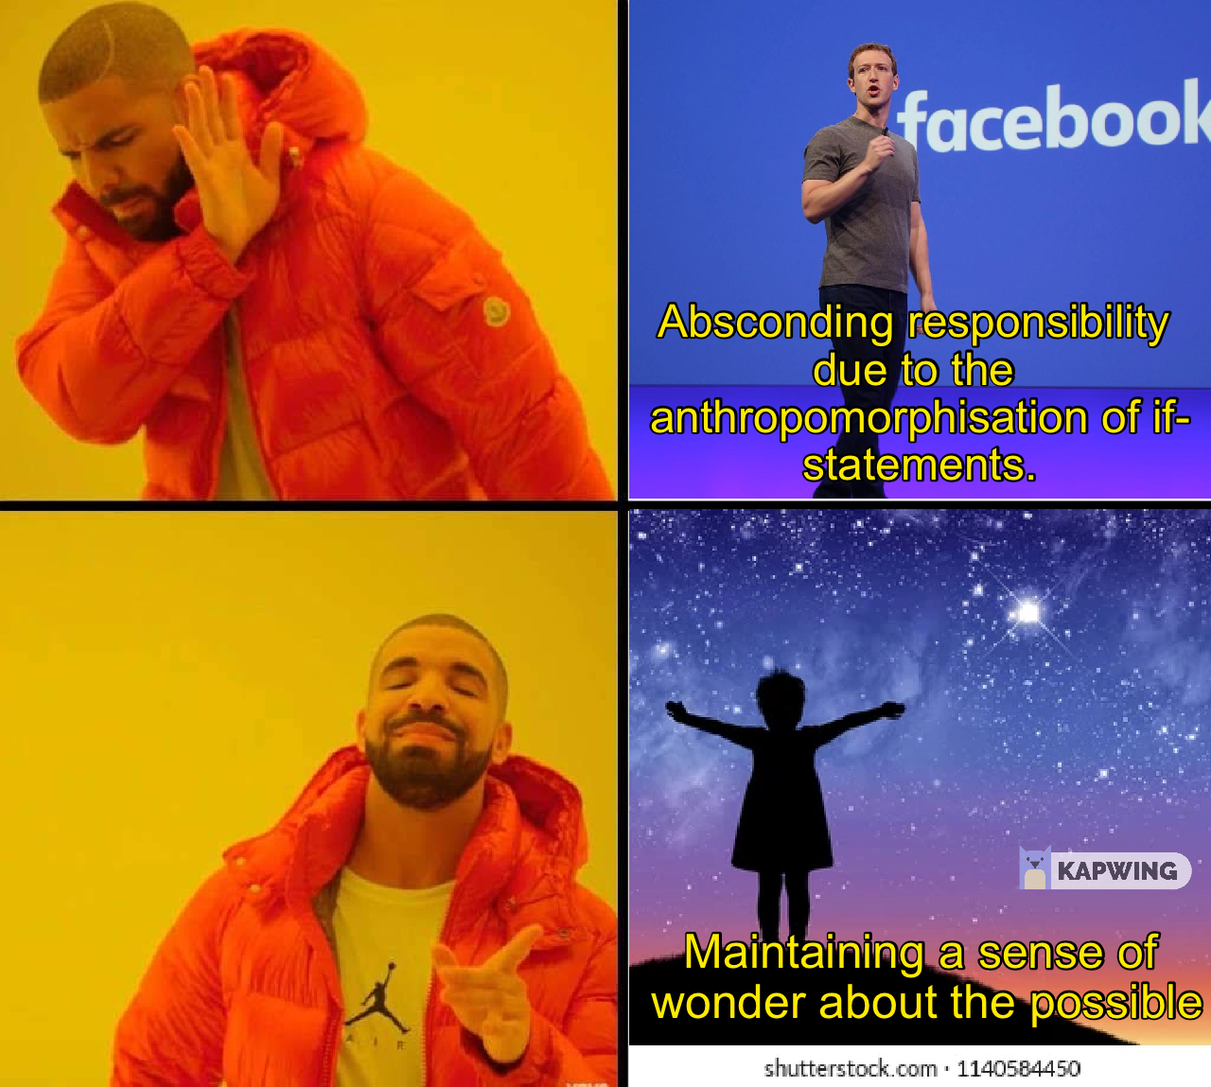
Stay Measured
Abnegating
AI is not magic
AI can be useful
Complementary methods for understanding:
Analytic/Formal/Interpretable
Numerical/Empirical/Explainable
Apply critical inquiry directly to forehead
The use of this meme macro does not condone the behavior of any of the individuals represented therein.

Slide 18


Syllabus Time

Slide 19
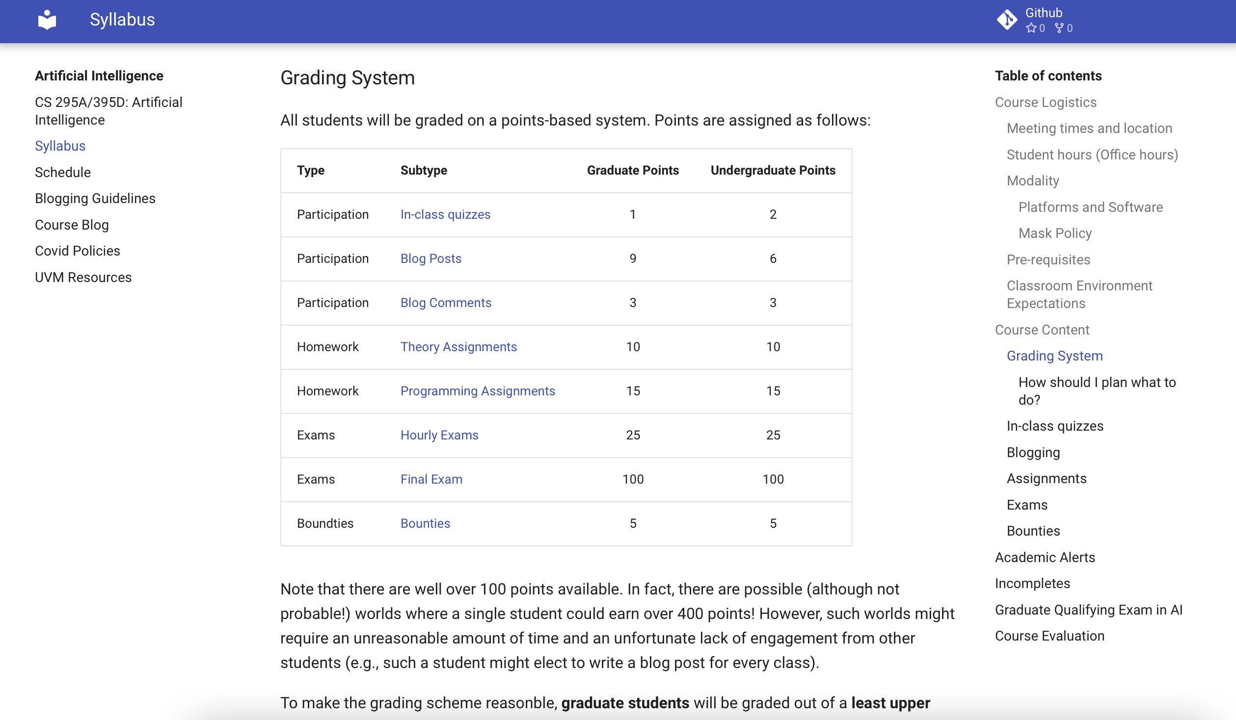

Slide 20
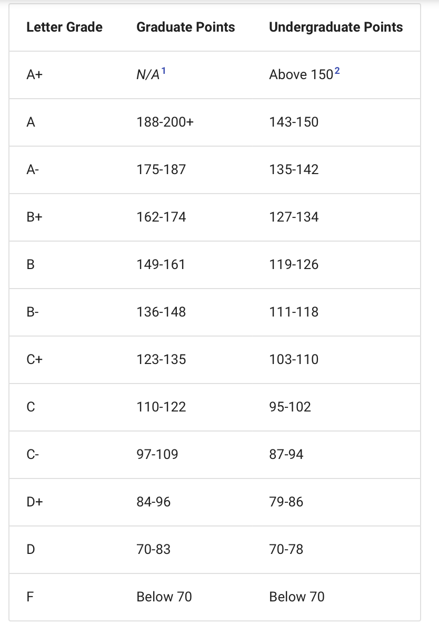
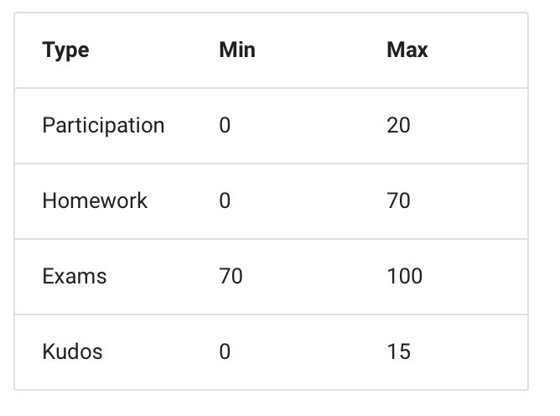
Only applies if you take the exam at the regular time.
Exam Info:
In person, on paper, closed-book
Make-up: within 1 week with note
50min class → aim for 25-30min exam
3pt deduction for leaving early

Slide 21
Assignment Info:
Programming
Soft deadline: exams
Hard deadline: last day of classes
Quasi-self-graded
Submit in BB
Theory
Soft deadline: 1 week before exam
Hard deadline: 1 class before exam
Autograded in BB, infinite retry
1 question autograded incorrectly

Slide 22
If you think you know the incorrectly marked answer, submit a formal justification in BB.
There may be legit mistakes…

Slide 23
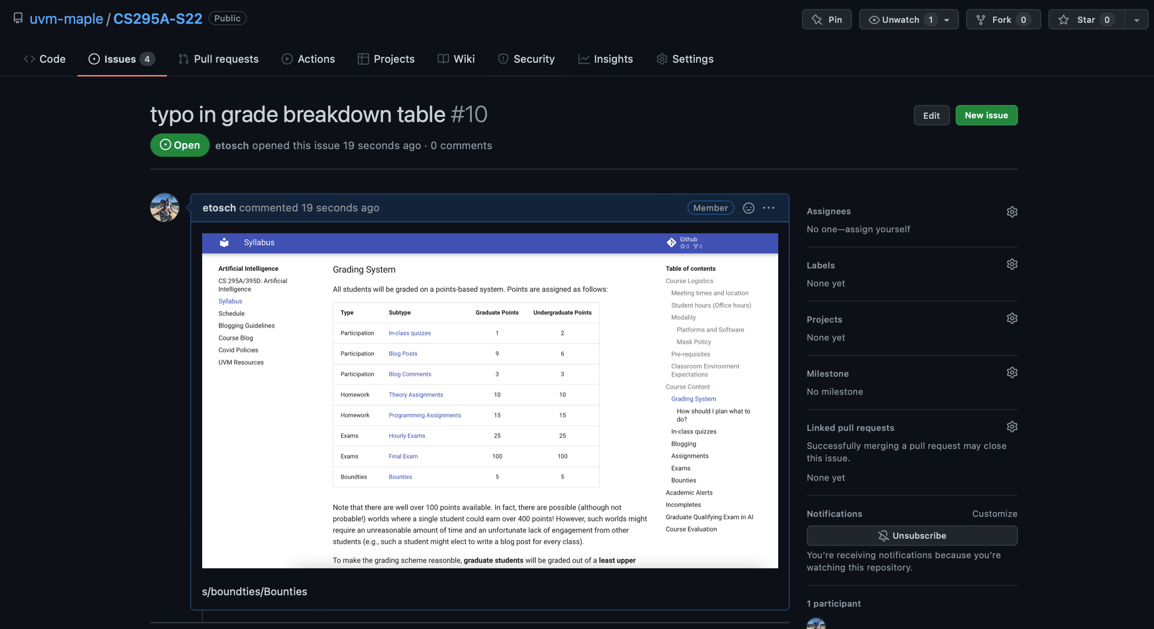

Slide 24


Slide 25
Example iClicker question
Have you had a course in discrete math or other course that covers induction, basic set theory, propositional logic, and similar topics?
Yes, more than one such course
Yes, but only one
I think so? But it’s kind of fuzzy.
I don’t think so?
Definitely not

